Slide 1
The Simple Regression Model
Lecture 3
y = β₀ + β₁x + u
Mechanics of OLS
Goodness of fit
The effect of change units of measurement on OLS
Expected values and variance of the OLS estimators

Slide 2
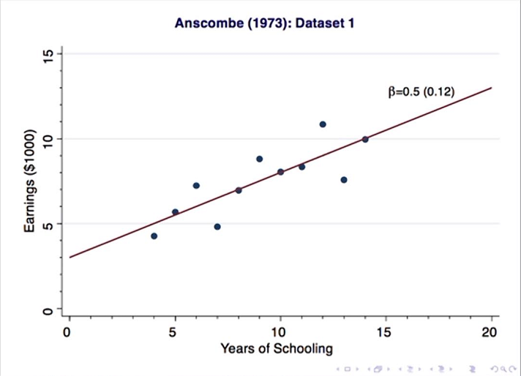

Slide 3
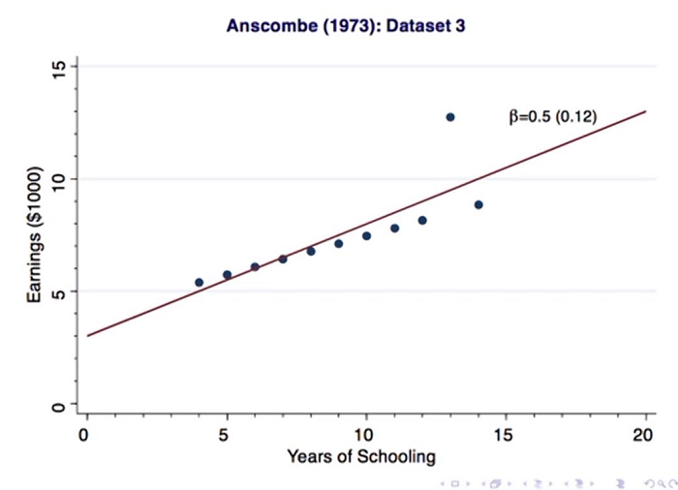

Slide 4
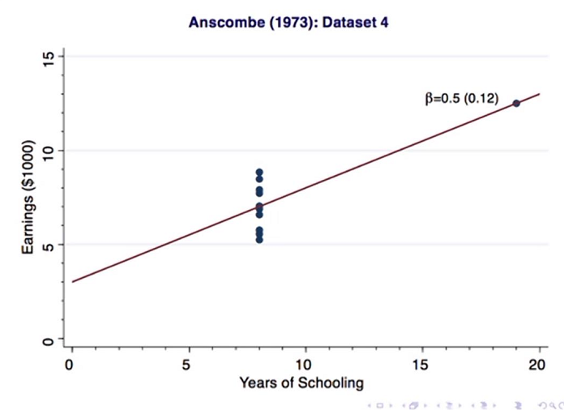

Slide 5
A Simple Assumption
About u term:
The average value of u (the error term) in the population is 0. That is,
E(u) = 0
This is not a restrictive assumption, since we can always use β₀ to normalize E(u) to 0

Slide 6
Zero Conditional Mean
A crucial assumption about how u and x are related
We want it to be the case that knowing something about x does not give us any information about u, so that they are completely unrelated. That is, that
E(u|x) = 0, which implies
E(y|x) = b0 + b1x

Slide 7
E(y|x) as a linear function of x, where for any x
the distribution of y is centered about E(y|x)
y
f(y)
.
.
E(y|x) = β₀ + β₁x
x₁
x₂

Slide 8
Ordinary Least Squares
Basic idea of regression is to estimate the population parameters from a sample
Let {(x_{i},y_{i}): i=1, …,n} denote a random sample of size n from the population
For each observation in this sample, it will be the case that
y_{i} = β₀ + β₁x_{i} + u_{i}

Slide 9
Population regression line, sample data points
and the associated error terms
y
E(y|x) = β₀ + β₁x
.
y₄
u₄
{
y₃
.
u₃
}
.
y₂
u₂
{
.
u₁
y₁
}
x₁
x₂
x₃
x₄
x

Slide 10
Deriving OLS Estimates
To derive the OLS estimates we need to realize that our main assumption of E(u|x) = E(u) = 0 also implies that
Cov(x,u) = E(xu) = 0
Why? Remember from basic probability that Cov(X,Y) = E(XY) – E(X)E(Y)

Slide 11
Deriving OLS estimator (continued)
We can write our 2 restrictions just in terms of x, y, β₀ and β₁ , since u = y – β₀ – β₁x
E(y – β₀ – β₁x) = 0
E[x(y – β₀ – β₁x)] = 0
These are called moment restrictions

Slide 12
Deriving OLS using M.O.M.
The method of moments approach to estimation implies imposing the population moment restrictions on the sample moments
What does this mean? Recall that for E(X), the mean of a population distribution, a sample estimator of E(X) is simply the arithmetic mean of the sample

Slide 13
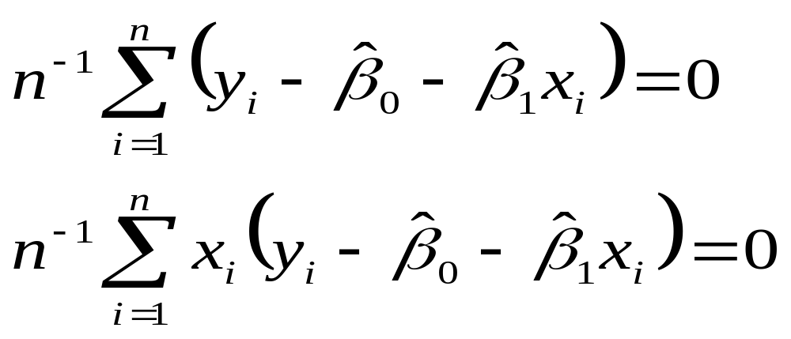
More Derivation of OLS
We want to choose values of the parameters that will ensure that the sample versions of our moment restrictions are true
The sample versions are as follows:

Slide 14
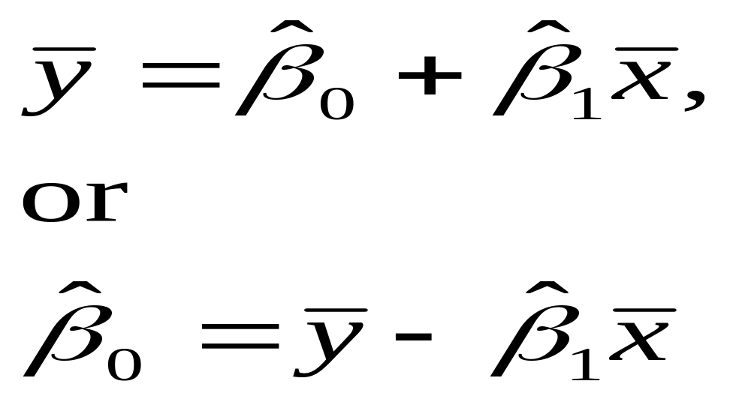
More Derivation of OLS
Given the definition of a sample mean, and properties of summation, we can rewrite the first condition as follows

Slide 15
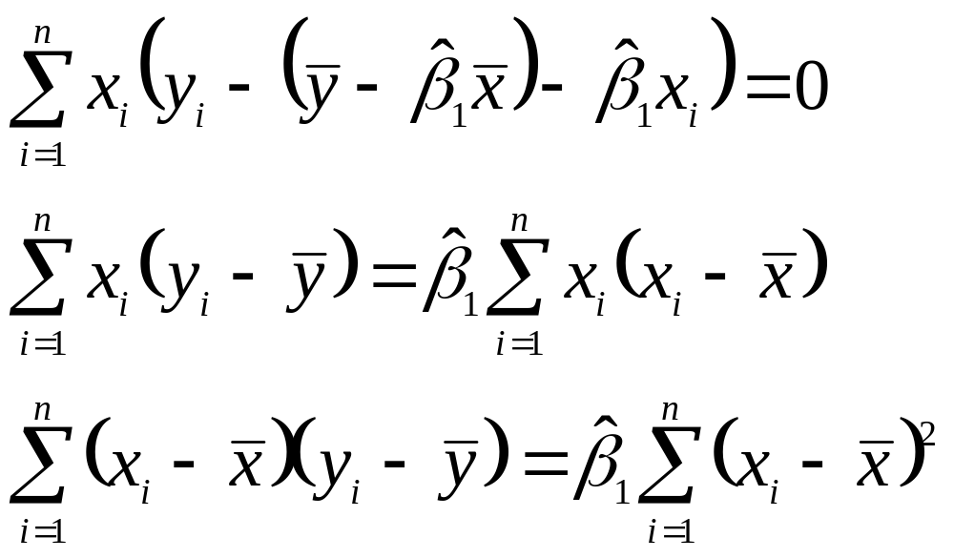
More Derivation of OLS

Slide 16
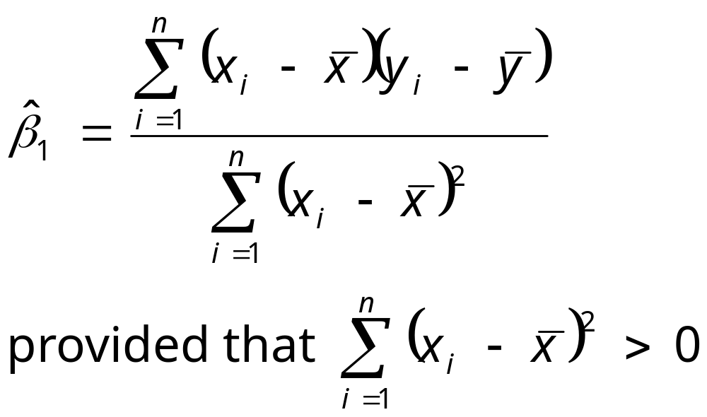
So the OLS estimated slope is

Slide 17
Summary of OLS slope estimate
The slope estimate is the sample covariance between x and y divided by the sample variance of x
If x and y are positively correlated, the slope will be positive
If x and y are negatively correlated, the slope will be negative
Only need x to vary in our sample

Slide 18
More OLS
Intuitively, OLS is fitting a line through the sample points such that the sum of squared residuals is as small as possible, hence the term least squares
The residual, û, is an estimate of the error term, u, and is the difference between the fitted line (sample regression function) and the sample point

Slide 19
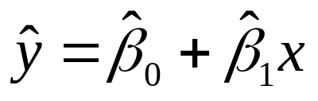
Sample regression line, sample data points
and the associated estimated error terms
y
.
y₄
{
û₄
}
û₃
y₃
.
.
y₂
û₂
{
}
û₁
.
y₁
x₁
x₂
x₃
x₄
x

Slide 20
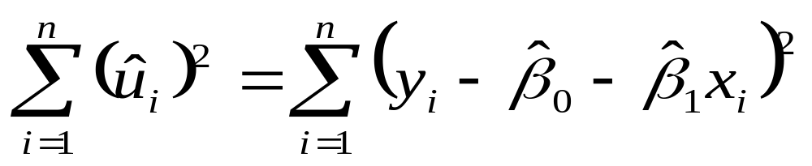
Alternate approach to derivation
Given the intuitive idea of fitting a line, we can set up a formal minimization problem
That is, we want to choose our parameters such that we minimize the following:

Slide 21
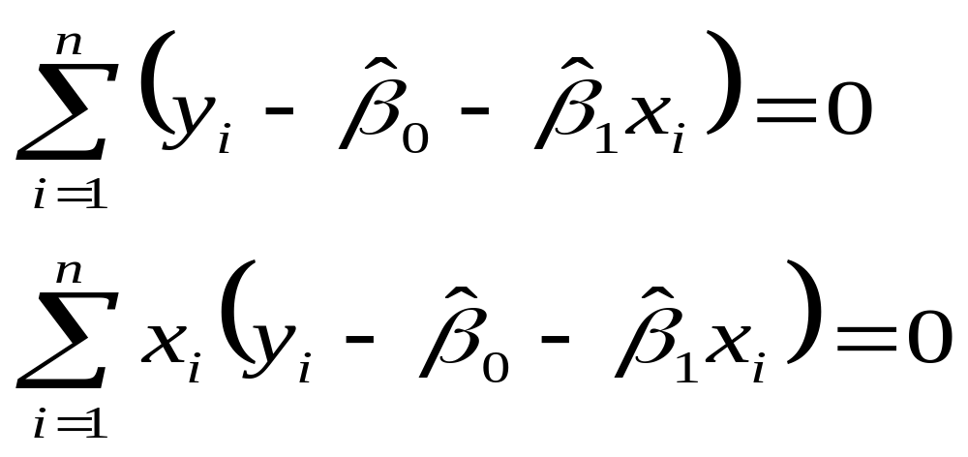
Alternate approach, continued
If one uses calculus to solve the minimization problem for the two parameters you obtain the following first order conditions, which are the same as we obtained before, multiplied by n

Slide 22
Algebraic Properties of OLS
The sum of the OLS residuals is zero
Thus, the sample average of the OLS residuals is zero as well
The sample covariance between the regressors and the OLS residuals is zero
The OLS regression line always goes through the mean of the sample

Slide 23
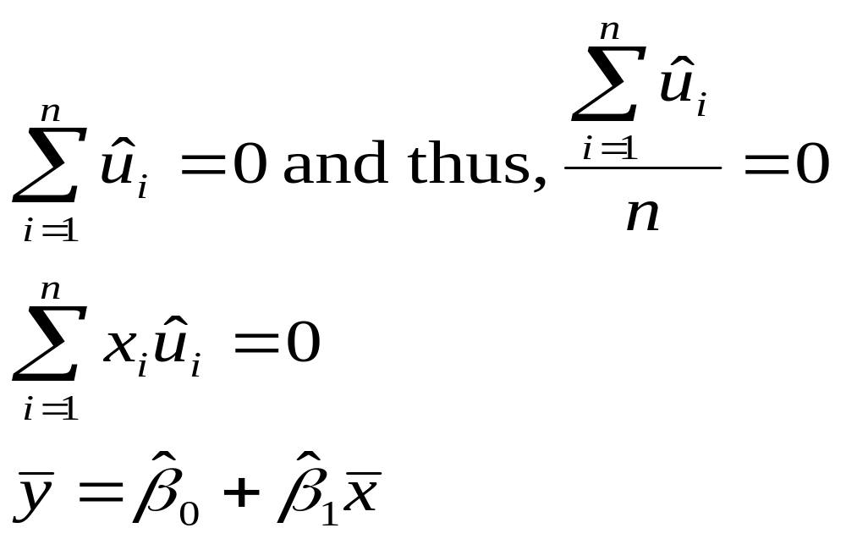
Algebraic Properties (precise)

Slide 24
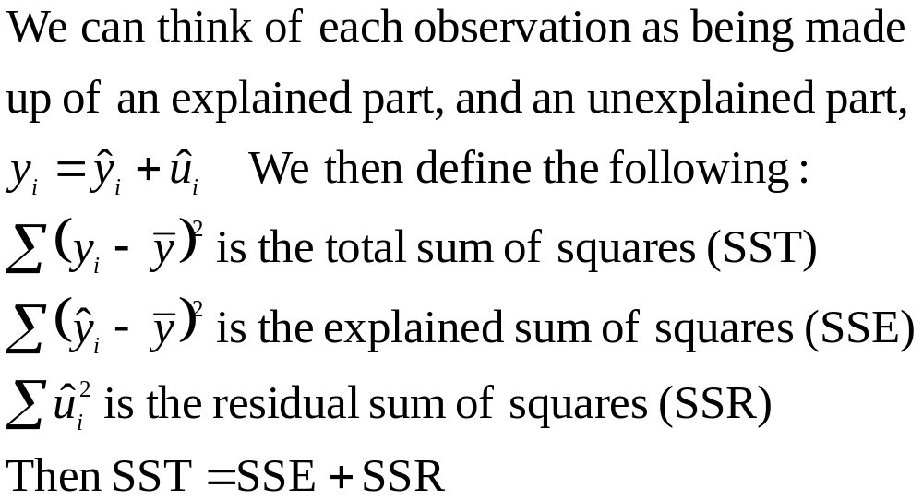
More terminology

Slide 25
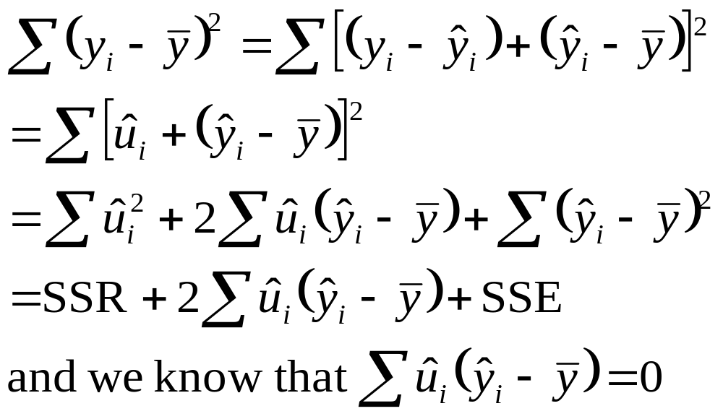
Proof that SST = SSE + SSR

Slide 26
Goodness-of-Fit
How do we think about how well our sample regression line fits our sample data?
We can compute the fraction of the total sum of squares (SST) that is explained by the model, call this the R-squared of regression
R² = SSE/SST = 1 – SSR/SST

Slide 27
R² is the fraction of the sample variation in y that is explained by x.
Two examples
Low R²
High R²
It is worth emphasizing now that a seemingly low R² does not necessarily mean that an OLS regression equation is useless.

Slide 28
Need to mention:
Changing units of measurements on OLS statistics.
Incorporating nonlinearities in simple regression
Model | Dependent variable | Independent variable
Level-level | y | x
Level-log | y | log(x)
Log-level | Log(y) | x
Log-log | Log(y) | Log(x)

Slide 29
Unbiasedness of OLS
Assume the population model is linear in parameters as y = β₀ + β₁x + u
Assume we can use a random sample of size n, {(x_{i}, y_{i}): i=1, 2, …, n}, from the population model. Thus we can write the sample model y_{i} = β₀ + β₁x_{i} + u_{i}
Assume E(u|x) = 0 and thus E(u_{i}|x_{i}) = 0
Assume there is variation in the x_{i}

Slide 30
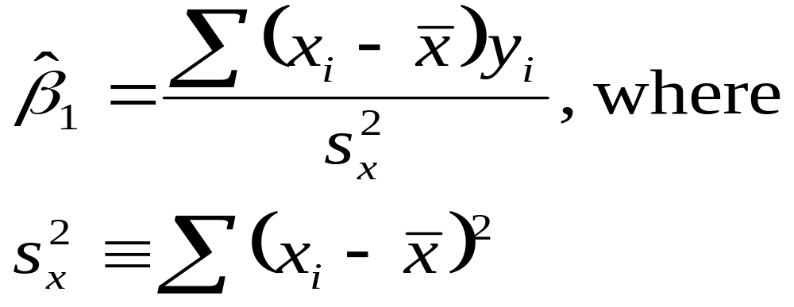
Unbiasedness of OLS (cont)
In order to think about unbiasedness, we need to rewrite our estimator in terms of the population parameter
Start with a simple rewrite of the formula as

Slide 31
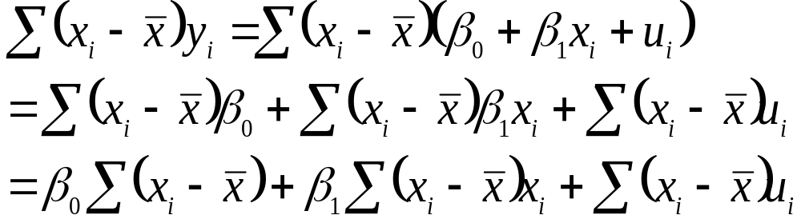
Unbiasedness of OLS (cont)

Slide 32
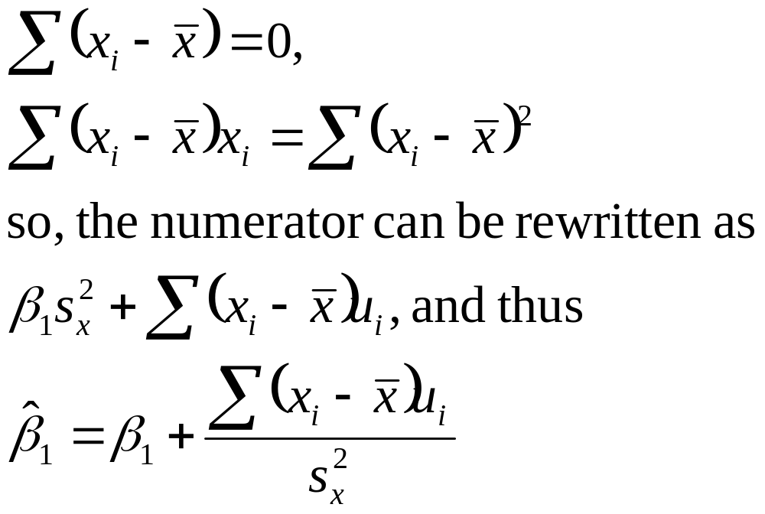
Unbiasedness of OLS (cont)

Slide 33
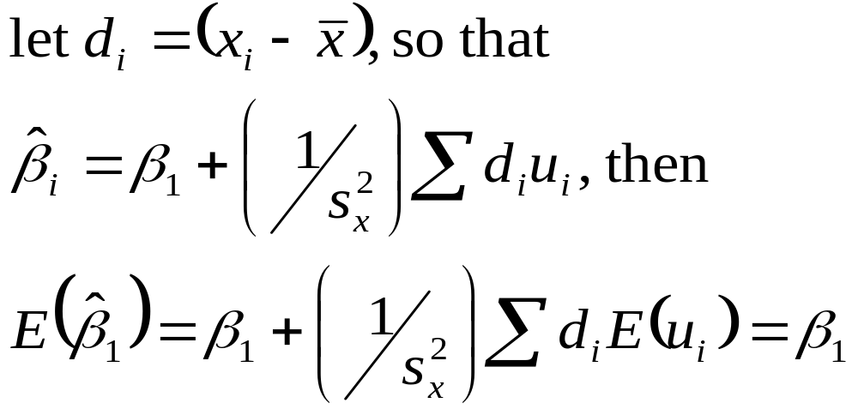
Unbiasedness of OLS (cont)

Slide 34
Unbiasedness Summary
The OLS estimates of β₁ and β₀ are unbiased
Proof of unbiasedness depends on our 4 assumptions(linear in parameters, random sampling, zero conditional mean, sample variation in the independent variable) – if any assumption fails, then OLS is not necessarily unbiased
Remember unbiasedness is a description of the estimator – in a given sample we may be “near” or “far” from the true parameter

Slide 35
Variance of the OLS Estimators
Now we know that the sampling distribution of our estimate is centered around the true parameter.
We now think about how spread out this distribution is.
Much easier to think about this variance under an additional assumption, so
Assume Var(u|x) = σ² (Homoskedasticity)

Slide 36
Variance of OLS (cont)
Var(u|x) = E(u²|x)-[E(u|x)]²
E(u|x) = 0, so σ² = E(u²|x) = E(u²) = Var(u)
Thus σ² is also the unconditional variance, called the error variance
σ, the square root of the error variance is called the standard deviation of the error
Can say: E(y|x)=β₀ + β₁x and Var(y|x) = σ²

Slide 37
Homoskedastic Case
y
f(y|x)
.
.
E(y|x) = β₀ + β₁x
x₁
x₂

Slide 38
Heteroskedastic Case
f(y|x)
y
.
.
E(y|x) = β₀ + β₁x
.
x₁
x₂
x₃
x

Slide 39
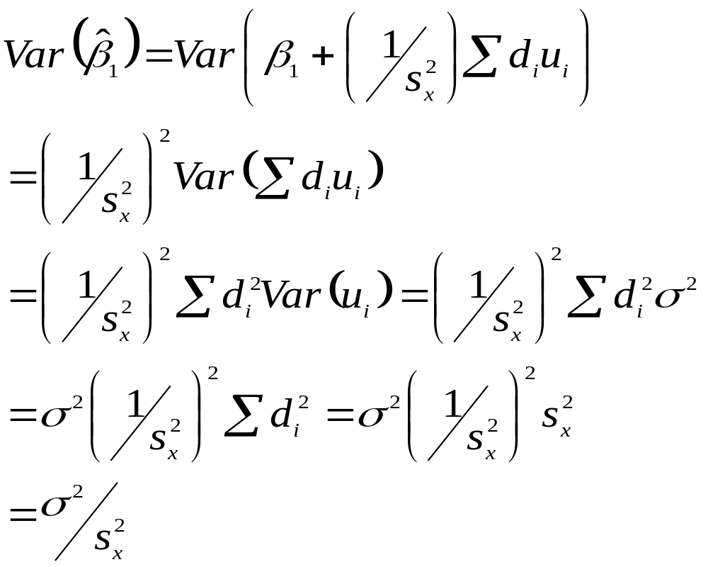
Variance of OLS (cont)

Slide 40
Variance of OLS Summary
The larger the error variance, σ², the larger the variance of the slope estimate
The larger the variability in the x_{i}, the smaller the variance of the slope estimate
As a result, a larger sample size should decrease the variance of the slope estimate
Problem is that the error variance of popultion is unknown

Slide 41
Estimating the Error Variance
We don’t know what the error variance, σ², is, because we don’t observe the errors, u_{i}
What we observe are the residuals, û_{i}
We can use the residuals to form an estimate of the error variance

Slide 42
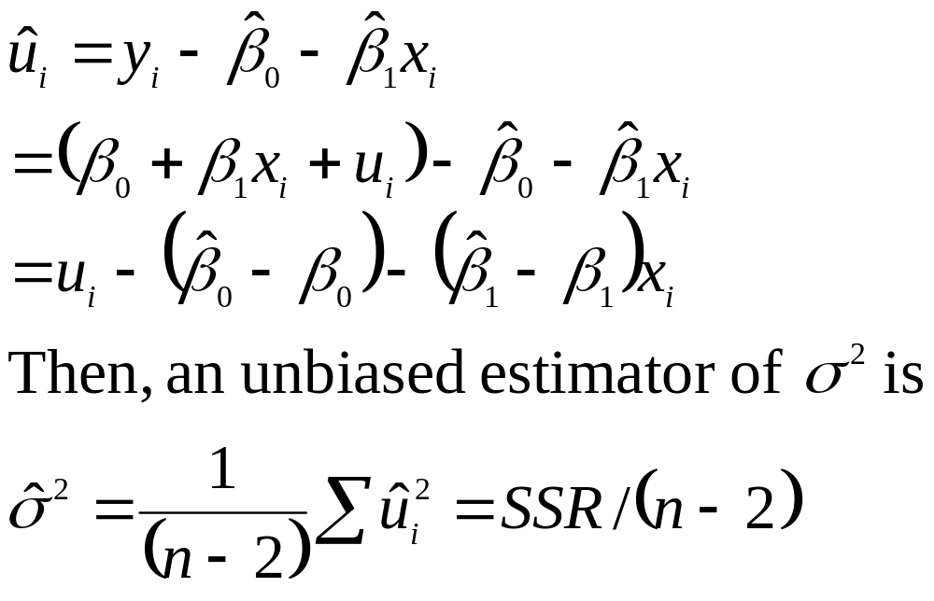
Error Variance Estimate (cont)

Slide 43
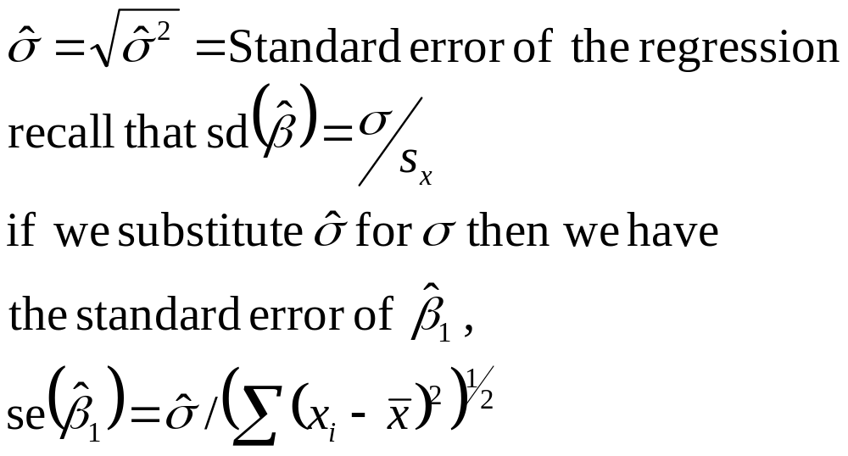
Error Variance Estimate (cont)

Slide 44
Homework
2.3, 2.7, 2.9
C2.1, C2.5, C2.7
Homework（9.12）

